Slide 1
Jiaying Guo
CS5610 Personal Homepage
From Finance to Computer Science
Fall 2026

Slide 2
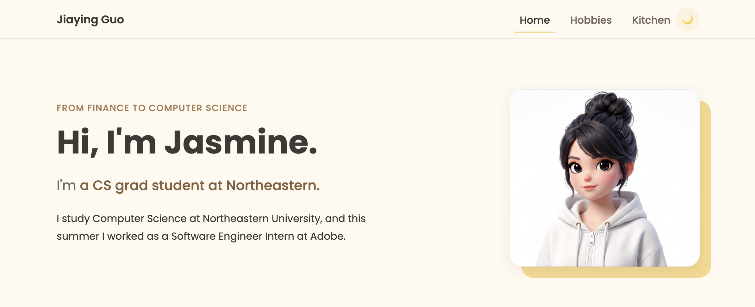
HOME
Hero
The first thing visitors see. My name and a short line about who I am.
The second line keeps typing and deleting. It cycles four phrases about me.
Made with a small vanilla JS module. The blinking caret is a CSS animation.

Slide 3
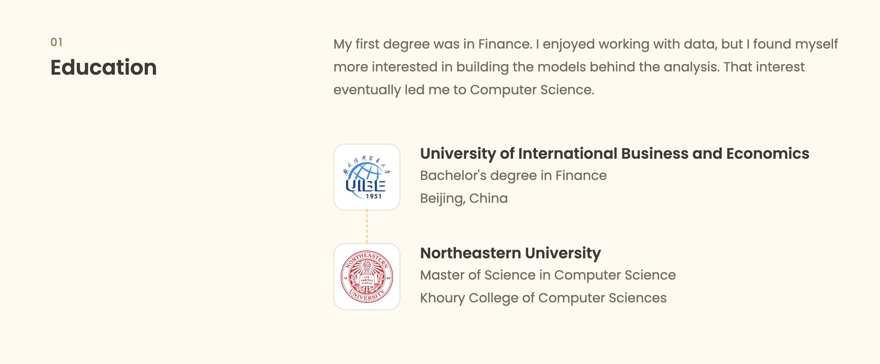
HOME
Education
Two schools linked by a dashed line, to show the switch from Finance to Computer Science.
UIBE in Beijing for my Bachelor in Finance, and Northeastern for my Master in CS.
The dashed line is a CSS pseudo element on the first school card.

Slide 4
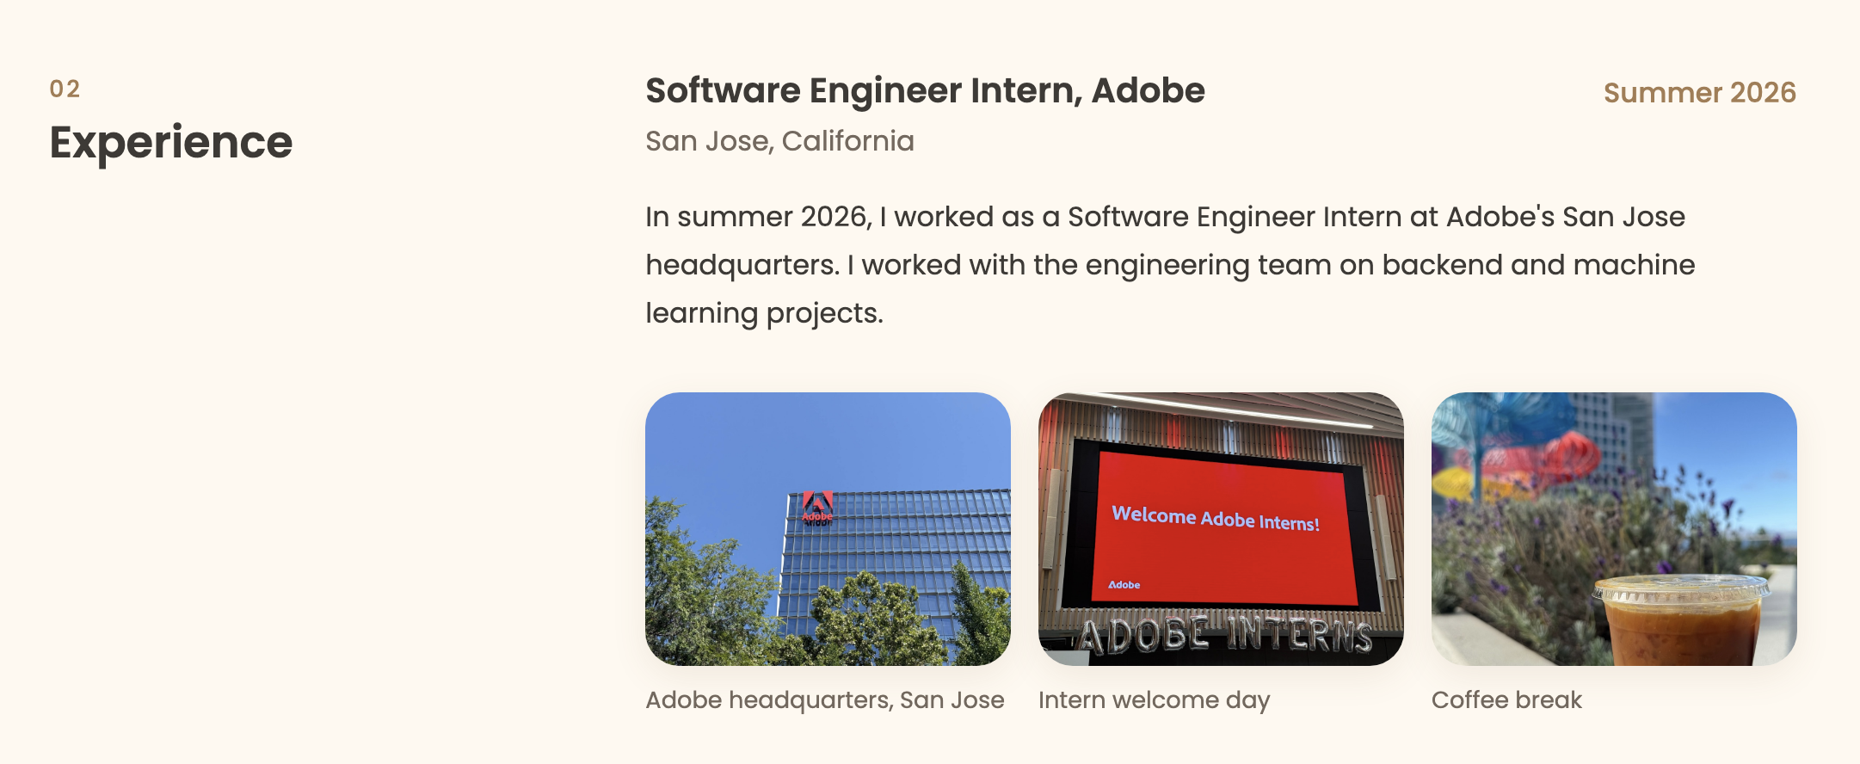
HOME
Experience
My Summer 2026 internship at Adobe in San Jose.
Three photos I took myself.
Hover on a photo and it zooms in, so you can see it more clearly. Just a CSS transform on hover.

Slide 5
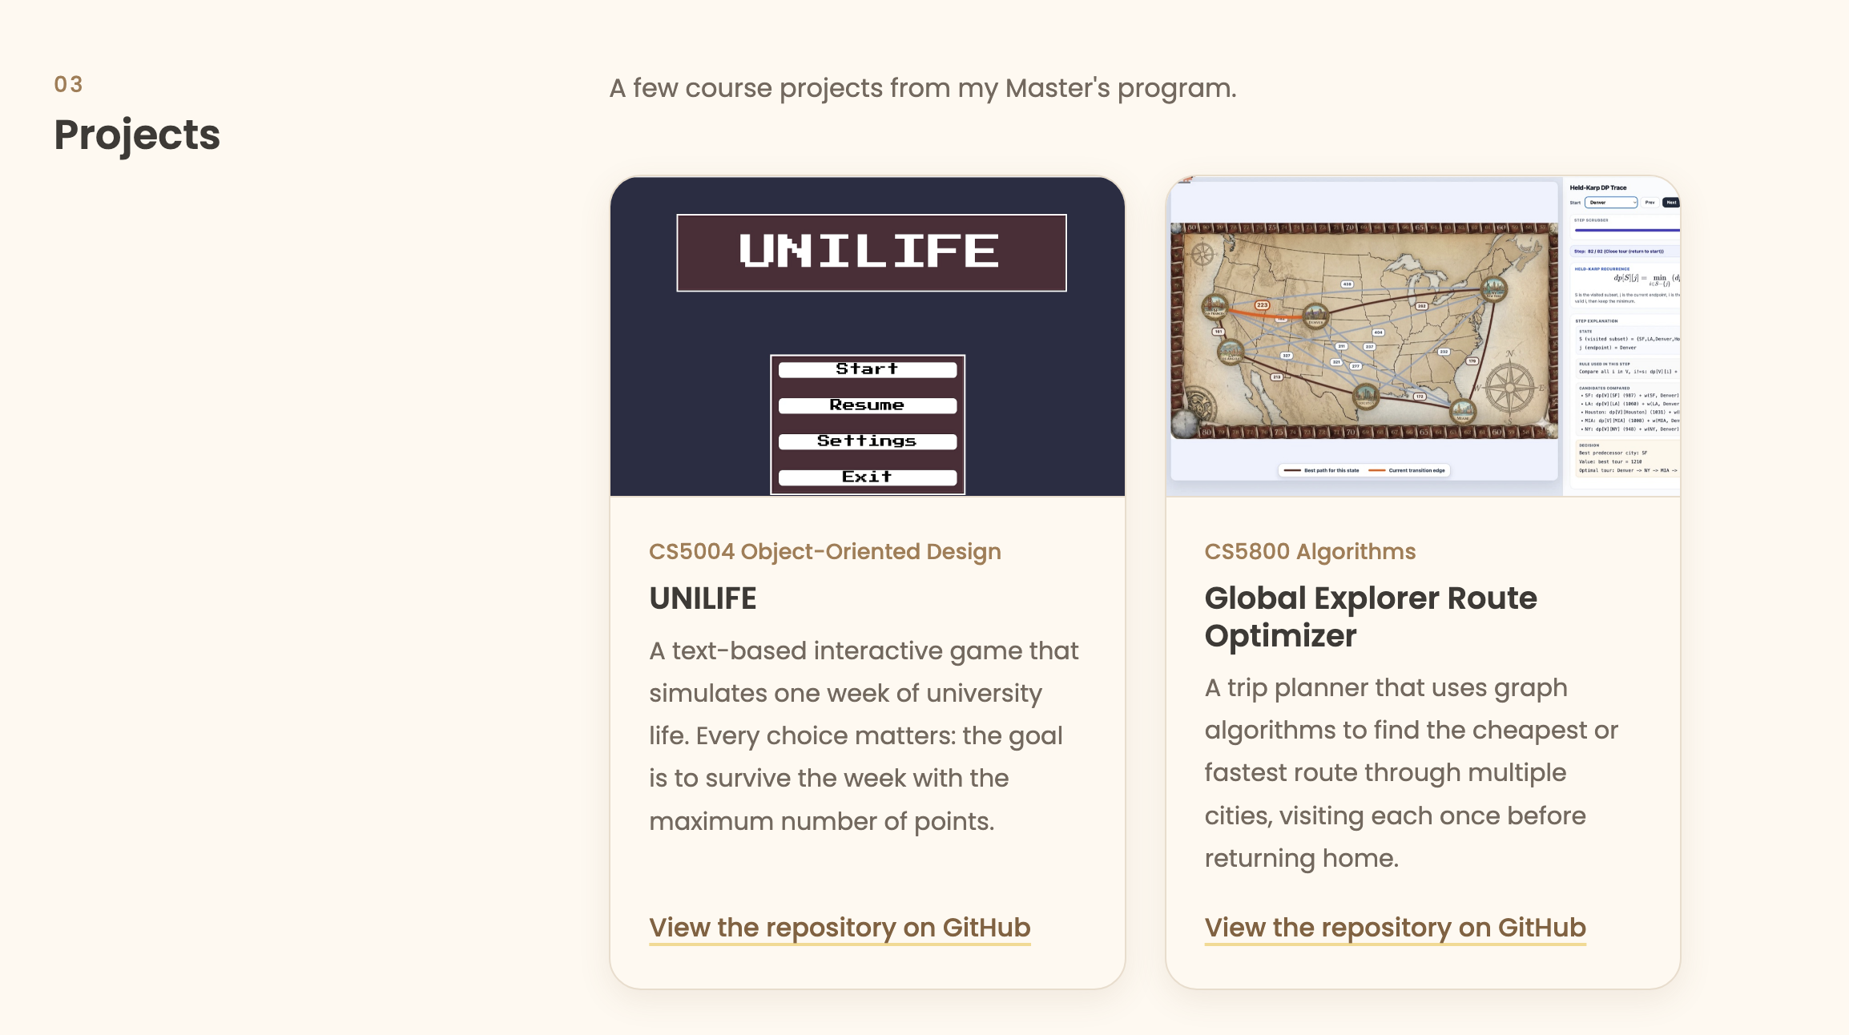
HOME
Projects
Two course projects. UNILIFE from CS5004 and Route Optimizer from CS5800.
Each card has a screenshot, a short description, and a link to the GitHub repo.
Bootstrap card layout, so the two cards stay the same height in one row.

Slide 6
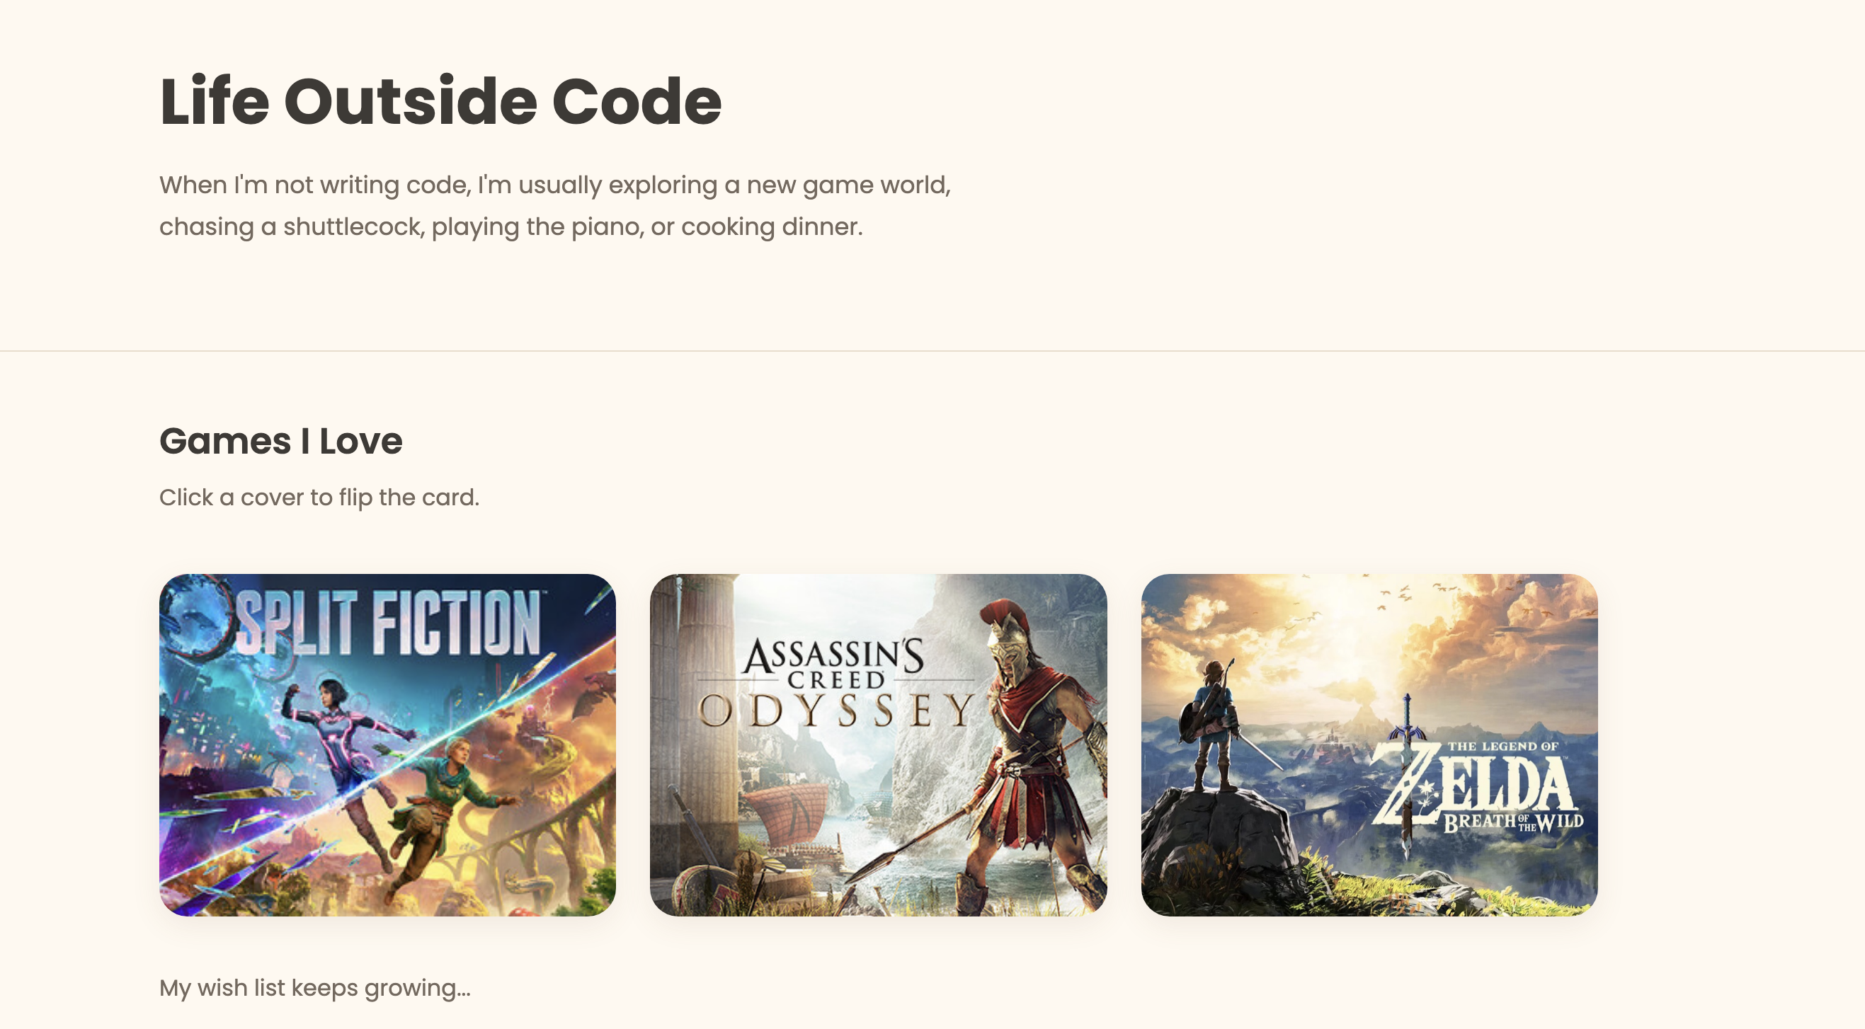
HOBBIES
Games I love
Three games I really love, shown as flip cards.
Click a cover and the card flips to show the game name and my note.
Each card is a real button, so keyboard and touch also work. The flip is a 3D CSS transform.

Slide 7
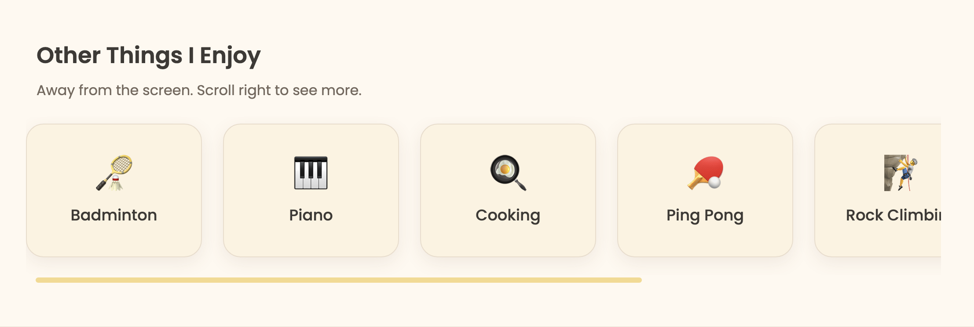
HOBBIES
Other things I enjoy
Badminton, piano, cooking, and a few more.
The row scrolls sideways, with scroll snap so each card stops in place.

Slide 8
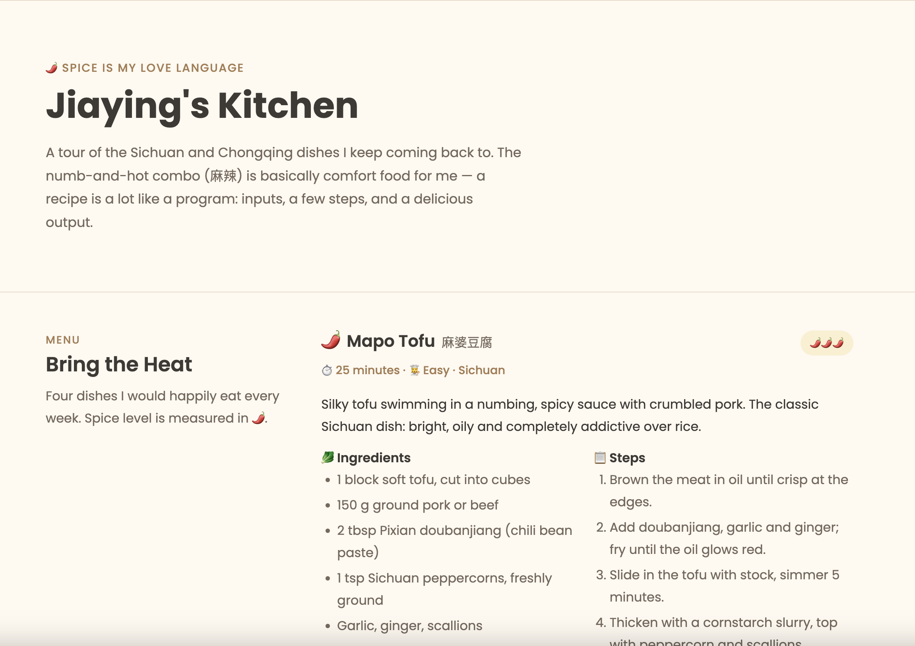
KITCHEN
The AI generated page

Slide 9
How I built it
Vanilla HTML5, CSS3 and ES6 modules. No jQuery.
Bootstrap 5 for the responsive grid and navbar.
Light and dark theme toggle. The site remembers your choice next time.
Formatted with Prettier. Passes ESLint and the W3C validator with zero errors.
Deployed on GitHub Pages.
github.com/Jasmine-G-uo/Jasmine-G-uo.github.io

